Slide 1


Water

Slide 2
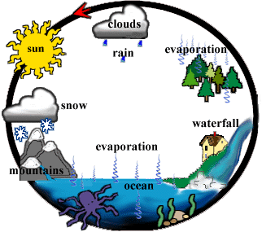

Slide 3


Evaporation

Slide 4
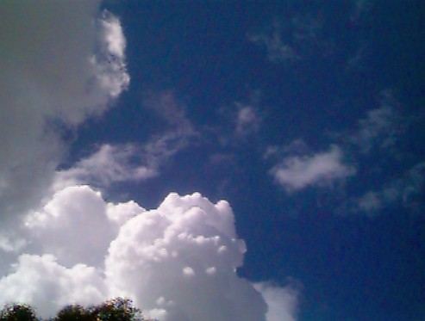
Condensation

Slide 5
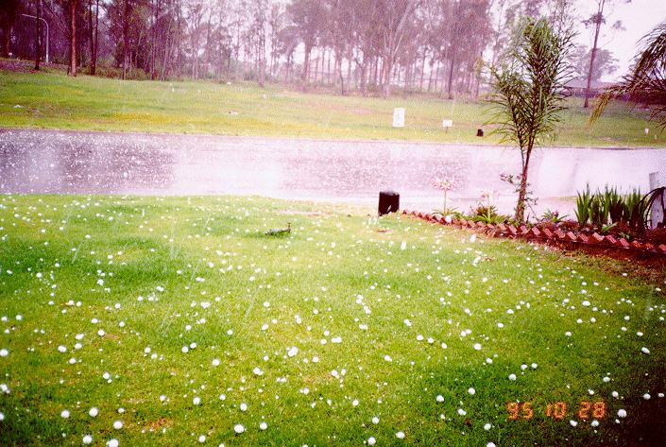
Precipitation

Slide 6

Transpiration

Slide 7

Source of Energy

Slide 8
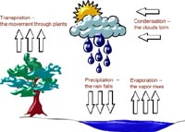
Condensation
The movement through plants
The Clouds form
Transpiration
Precipitation
The rain falls
Evaporation
The vapor rises

Slide 9

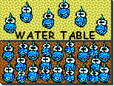
Ground Water

Slide 10
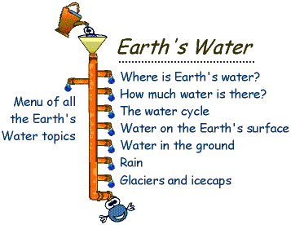

Slide 11

Water Chemical Properties
-
-
H
H
Two atoms of hydrogen
o
One atom of oxygen
+

Slide 12



Slide 13


Slide 14
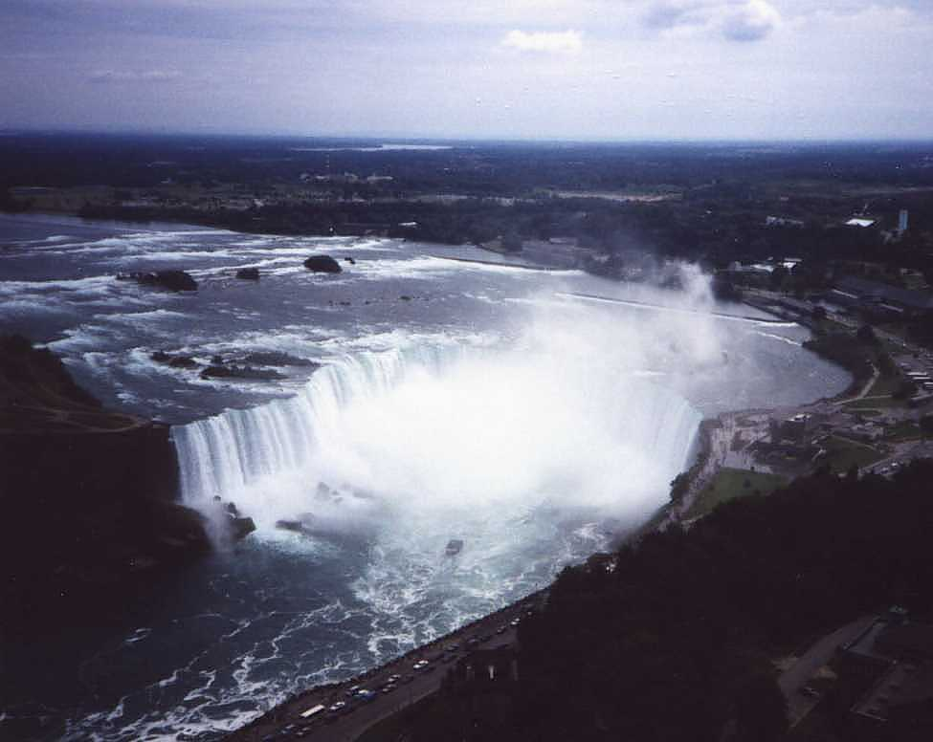

Slide 15


